Slide 1
CAPSTONE PROJECT REVIEW-2 NEXT-GEN BALANCE MANAGEMENT SYSTEM BY- KOMAL GULATI 17BCE0596

Slide 2
Abstract-
The traditional balance management system which uses RDMS, maintains the account balance in one table where key of the table is account number. Whenever a debit or credit is performed, the balance in this table is updated for the account. As banks cannot allow the withdrawal amount more than the balance only one transaction is allowed on one account at a point of time.
However there are many accounts in banks which require multiple transactions at same time. In other words concurrency requirement is very high for some accounts. In memory processing is always faster than write to the disk.
So we need a solution which can utilize power of in memory transactions as well as safe guard bank by not losing the data in case of any failure.
REDIS is key value in-memory datastore, so in the new solution we will maintain the account balance in REDIS, so the concurrent transactions can happen very fast.
New System will write the data into new table which has very few indexes, so inserts will be fast.

Slide 3
Problem Statement-
Earlier
Most of payments done using cash / cheque / demand draft
Volumes of payments was very less.
System mainly used by bank employees in branches
Now
Most of payments done using digital channels like Mobile Apps / Internet banking
Volumes of payments is very high
Mobile phones has made customers also as users of banking / payment system.
The traditional legacy applications based on simple CRUD operations in RDBMS are either not able to scale to meet the rapid increase in volume of digital payments or become costly in terms of hardware, infrastructure or operations.

Slide 4
Problem Statement-
Concurrent Transactions-
Let us take the example of Google Pay Reward Account with ICICI or HDFC Bank.
In one second, the number of debits happening to Reward account may be in hundreds.
To ensure account does not go into negative balance, traditional method of updating the database requires locking and updating the row in the database with every transaction. This becomes the real bottleneck .

Slide 5
Problem Statement-
Response Time-
The time required to update the balance table and insert into transaction and other reporting table for every transaction during withdrawal or deposit has kept on increasing due to volumes, and it has reached the maximum acceptable limit.

Slide 6
Objective
A solution, which provides extremely efficient processing of withdrawal or deposit of funds with a low response time and high concurrency.
The new solution should be deployable in production along with existing solution without much changes in existing solution to minimize the impact.

Slide 7
Existing System Architecture
Receive Debit Request
Receive Balance Or Statement Inquiry
Load Account From Database
Read from Db and process
Lock Account Balance Row
Process Debit
Update the Balance
Insert Transaction

Slide 8
Drawback of existing work
Each debit request has to wait for previous debit request, as row in database is locked
High Response Time due to wait for lock in database
Not possible to perform 100 of transactions per second on same account due to wait, means low concurrency
Every Balance and Statement Inquiry puts load on the RDBMS
Higher Total cost of ownership

Slide 9
Proposed Model
New system will co-exists with current system for 1-2 years
New system will provide REST APIS for
Withdrawal
Deposit
Balance Inquiry
New balance management system will use REDIS for an in-memory dataset cache
A minimum change will be done in current system also to keep REDIS up to date without changing the current flow or processing to minimize the impact

Slide 10
Proposed Model
SOAP
XML
APIS
New
BMS
Current
System
SQL
RDBMS
New Tables

Slide 11
Proposed Architecture
Receive Debit Request
Receive Balance Or Statement Inquiry
Read Account Information
from REDIS Cache
Read from REDIS and process
Decrement the balance in REDIS
Insert transaction in REDIS
Perform Basic Validation
Process Debit Request
Insert Transaction in DB in Request Table
Asynchronous Process
Update Account Balance Table (Bulk)
(not transaction by transaction)
If data is not available in REDIS
It is loaded from DB, and put into REDIS
Insert into Actual Transaction Table

Slide 12
Appropriate Methodologies
REST APIS
New APIS are in JSON format and follow REST model
03
Cache and Stream
Make use of REDIS Cache
REDIS is highly scalable distributed cache and streaming system
01
02
No Impact on existing System
New system should work in coexistence model with old system with no impact and minimum changes in current system

Slide 13
Appropriate Methodologies
REST APIs
REST APIs provide a great deal of flexibility to meet the needs of very diverse customers.
REST APIs allow client and the server to evolve individually and decouples them.
REST APIs are stateless, meaning that calls can be made independently of one another, and each call contains all of the data necessary to complete itself successfully.

Slide 14
Appropriate Methodologies
Cache and Stream
To achieve top performance, Redis will be used which works with an in-memory dataset.
In case of debit the balance is reduced in REDIS first and then transaction is committed in database.
In case of credit, the transaction is first committed in database and then balance is increased in REDIS

Slide 15
Appropriate Methodologies
No impact on Existing System
There are lot of reports written based on current DB design, so that should not be changed to avoid rewriting the reports.
New System will write the data into new table which has very few indexes, so inserts will be fast
Asynchronously, data will be written into old tables, to ensure current reports continue to work as is.

Slide 16
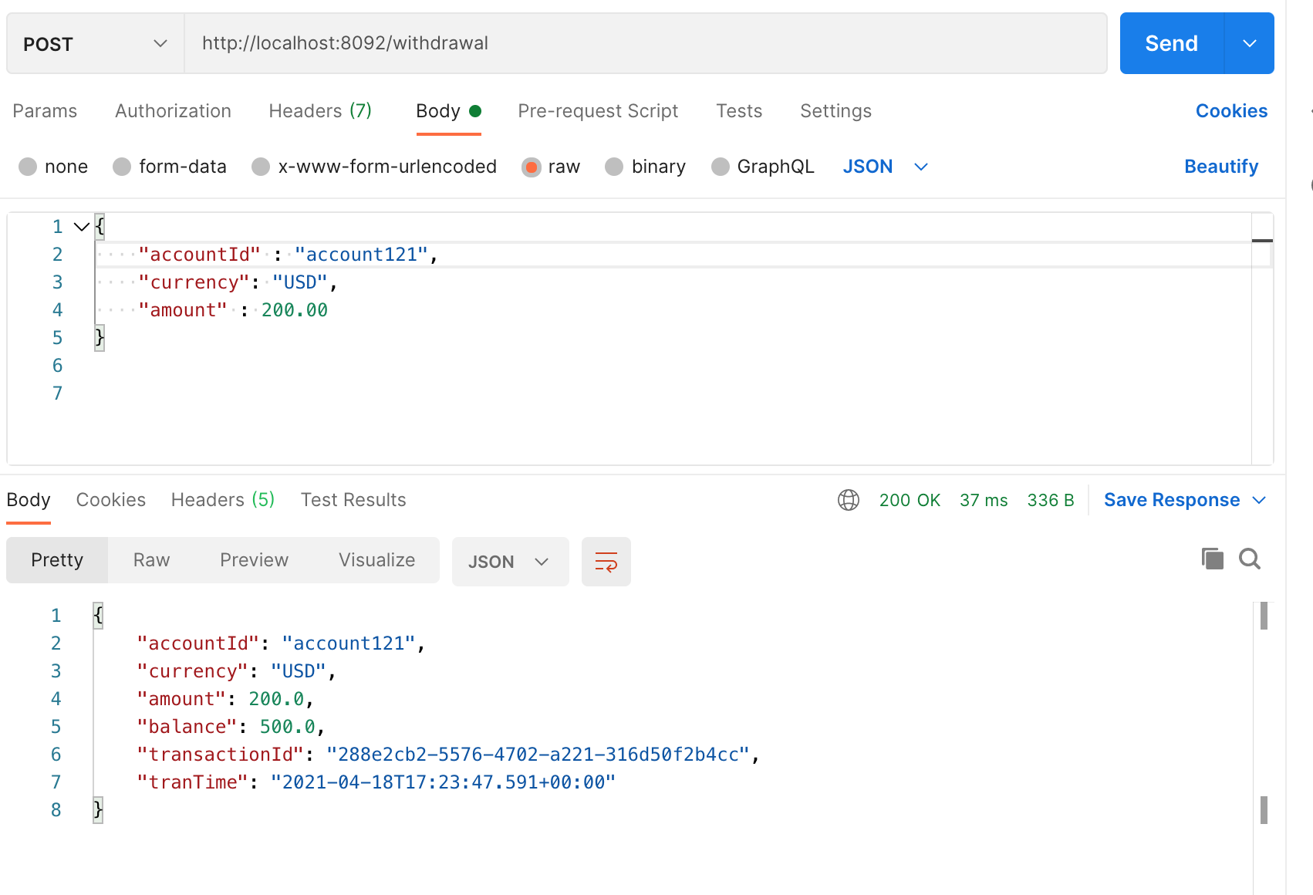
Testing the API – Postman Tool

Slide 17
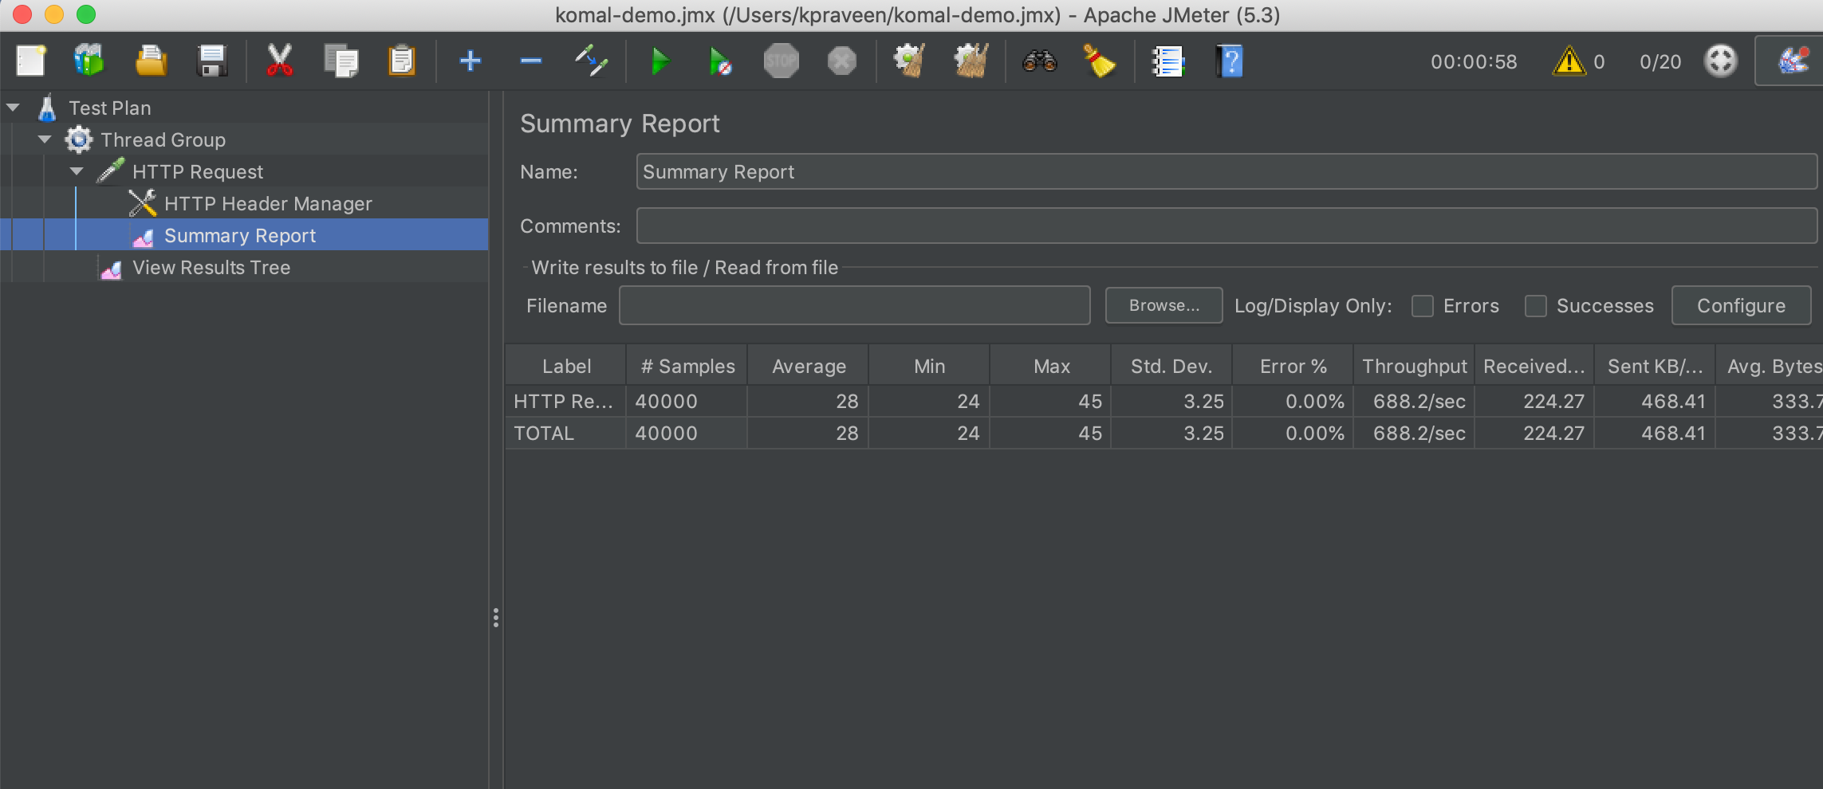
jMeter – Tool to measure performance
Average Response Time
28ms
Throughput :
688 per second
Concurrent users
20
Error Percentage
0
Number of requests tested
40000

Slide 18
CONCLUSION-
In the traditional system,whenever a transaction is performed on account, balance table is locked for the row, so concurrent updates on same account becomes sequential.
For example, if one transaction is taking 200 ms. Only 5 transactions per second can happen on one account.
In new solution there will no locking so one request will not wait for another request. By using in memory database (REDIS) we will be able to process transaction requests concurrently.
Suppose we are now able to process transaction request in 50ms, due to lesser indexes in new transaction table and no lock, 20 requests per second can happen sequentially itself, but because we will be doing concurrent requests, it will be possible to 100 of concurrent requests per second.

Slide 19
References
https://redis.io/
https://www.business-standard.com/article/economy-policy/digital-payments-rise-at-55-cagr-vy-volume-in-five-years-to-fy20-rbi-data-120101100400_1.html
https://www.investopedia.com/terms/a/accountbalance.asp

Slide 20
THANK YOU!

